Slide 1
2020 Census EA Framework Selection & Customization
George Mason University
Course: Spring 2017 Enterprise Architecture
Professor: Barry M. Barlow
Date: 2017/05/01
Presenter: Linus W. Freeman III
2020 Census Enterprise Architecture and Infrastructure Transition Plan (CEAITP): EA Framework Selection & Customization

Slide 2
2020 Census EA Framework Selection
Scope: The Census Bureau is an agency of the Commerce Department
The initial list of possible EA Framework selections could be:
The Zachman Framework
Federal Enterprise Architecture Framework (FEAF)
The Open Group Architecture Framework (TOGAF)
Enterprise Architecture Planning (EAP)

Slide 3
2020 Census EA Framework Selection #2
Considerations:
The Zachman Framework handles large scale complexity potentially better than the FEAF and TOGAF frameworks.
But the Census Bureau Enterprise Architecture scope is only for the individual agency.
So the Zachman Framework may be overkill and not the best fit.

Slide 4
2020 Census EA Framework Selection #3
FEAF, TOGAF, and EAP are the remaining frameworks being considered now.
TOGAF might be a lighter weight framework that would be a better fit than FEAF.
But because the Census Bureau needs a customized simpler version for their framework, EAP is chosen over TOGAF with a customized added top level Strategy View and two cross cutting views of Security and Quality (data quality, scalability, reliability and performance).

Slide 5
2020 Census EA Framework Selection #4
It is determined that EAP with customization offers the least complexity for structuring the 2020 Census Bureau Enterprise Architecture and Infrastructure Transition Plan.
Rationale: EAP is simpler to adopt, adapt, customize and tailor to the needs of the Census government agency.

Slide 6
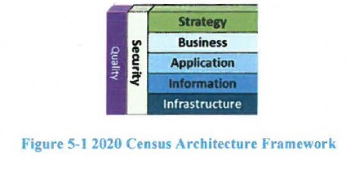
Notes:
The 2020 Census architecture is described in the context of the seven domains as shown in Figure 5-1.
The Strategy Domain consists of the program vision and mission level business requirements.
The Business Domain describes business goals and business operations.
The Application Domain describes the application areas and their respective systems and services.
The Information Domain describes the enterprise information and data dictionary.
The Infrastructure Domain describes the supporting segments and operations.
The Security Domain describes the security features and mechanisms throughout all of the other domain areas.
The Quality Domain describes the support for scalability, reliability, and performance dimensions.

Slide 7
End of 2020 Census EA Framework Selection and Customization Presentation
Any Questions?

